Slide 1
GenAI-Enabled Integrated Platform Environment (IPE)
Hackathon Presentation
Team AI-Vengers
Jagan VS
Suneel Gandham
Ansar Bhasha Shaik
Vinod A

Slide 2
Problem Statement
Technology organizations have a large platform support system with L1/L2/L3 operations. Support teams need to troubleshoot incidents by accessing multiple knowledge bases, automation scripts, telemetry data, and configuration details. This results in significant time loss due to frequent context switching.

Slide 3
Solution Overview
GenAI-enabled Integrated Platform Environment (IPE) provides an AI-powered support console. It integrates knowledge bases, automation scripts, telemetry, and enterprise data into a unified platform.

Slide 4
Key Features
- AI Chatbot for intelligent responses
- Agentic capabilities for automated incident resolution
- Contextual recommendations based on enterprise data
- Integration with ITSM, observability tools, and automation frameworks

Slide 5
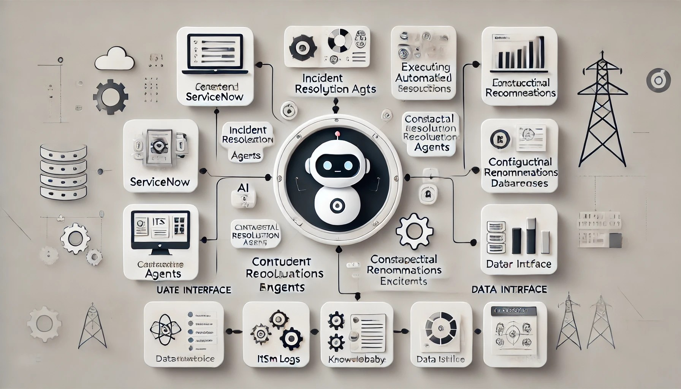
Architecture Diagram

Slide 6
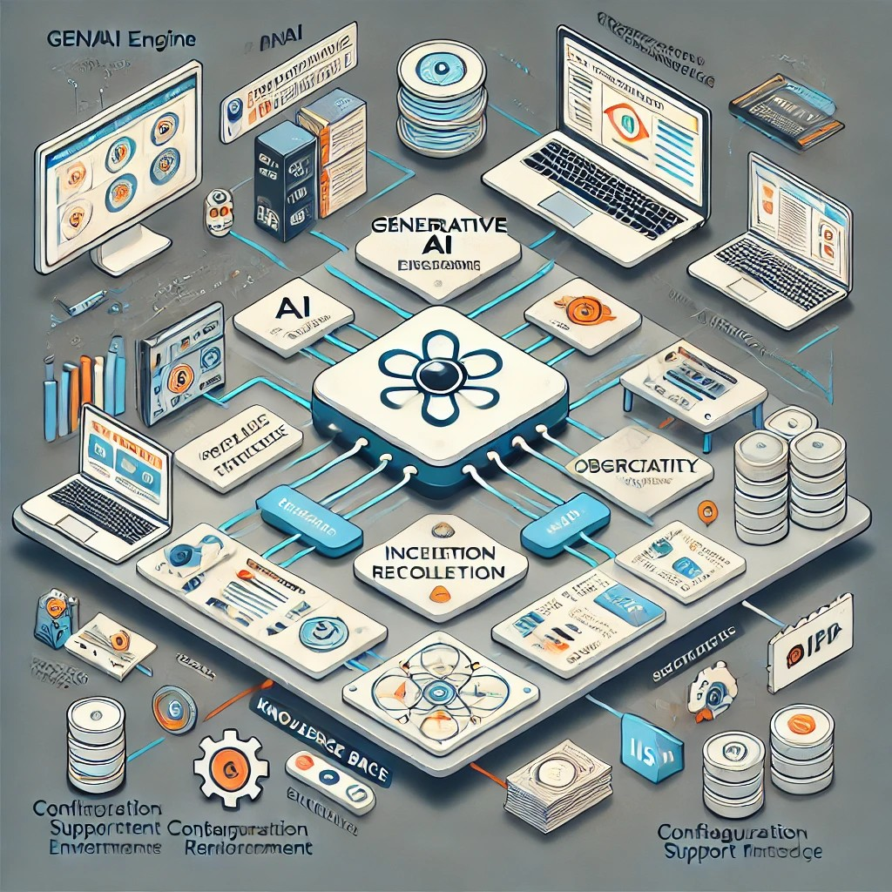
Process Flow Diagram

Slide 7
Implementation Details
Retrieval-Augmented Generation (RAG) chatbot for knowledge retrieval
Ansible scripts for automated incident resolution
Integration with ServiceNow, ITSM, and monitoring tools (Mocked Data)
Limitations:
We have mocked the responses for AI Agents considering time limit.

Slide 8
Benefits & Impact
Reduces time spent switching between tools
Provides faster and more accurate incident resolution
Increases efficiency of platform support teams

Slide 9
Future Enhancements
Extend AI capabilities with predictive analytics
Improve integration with more ITSM and monitoring tools
Enhance user experience with interactive dashboards

Slide 10
Conclusion & Q&A
Thank you!

